Slide 1
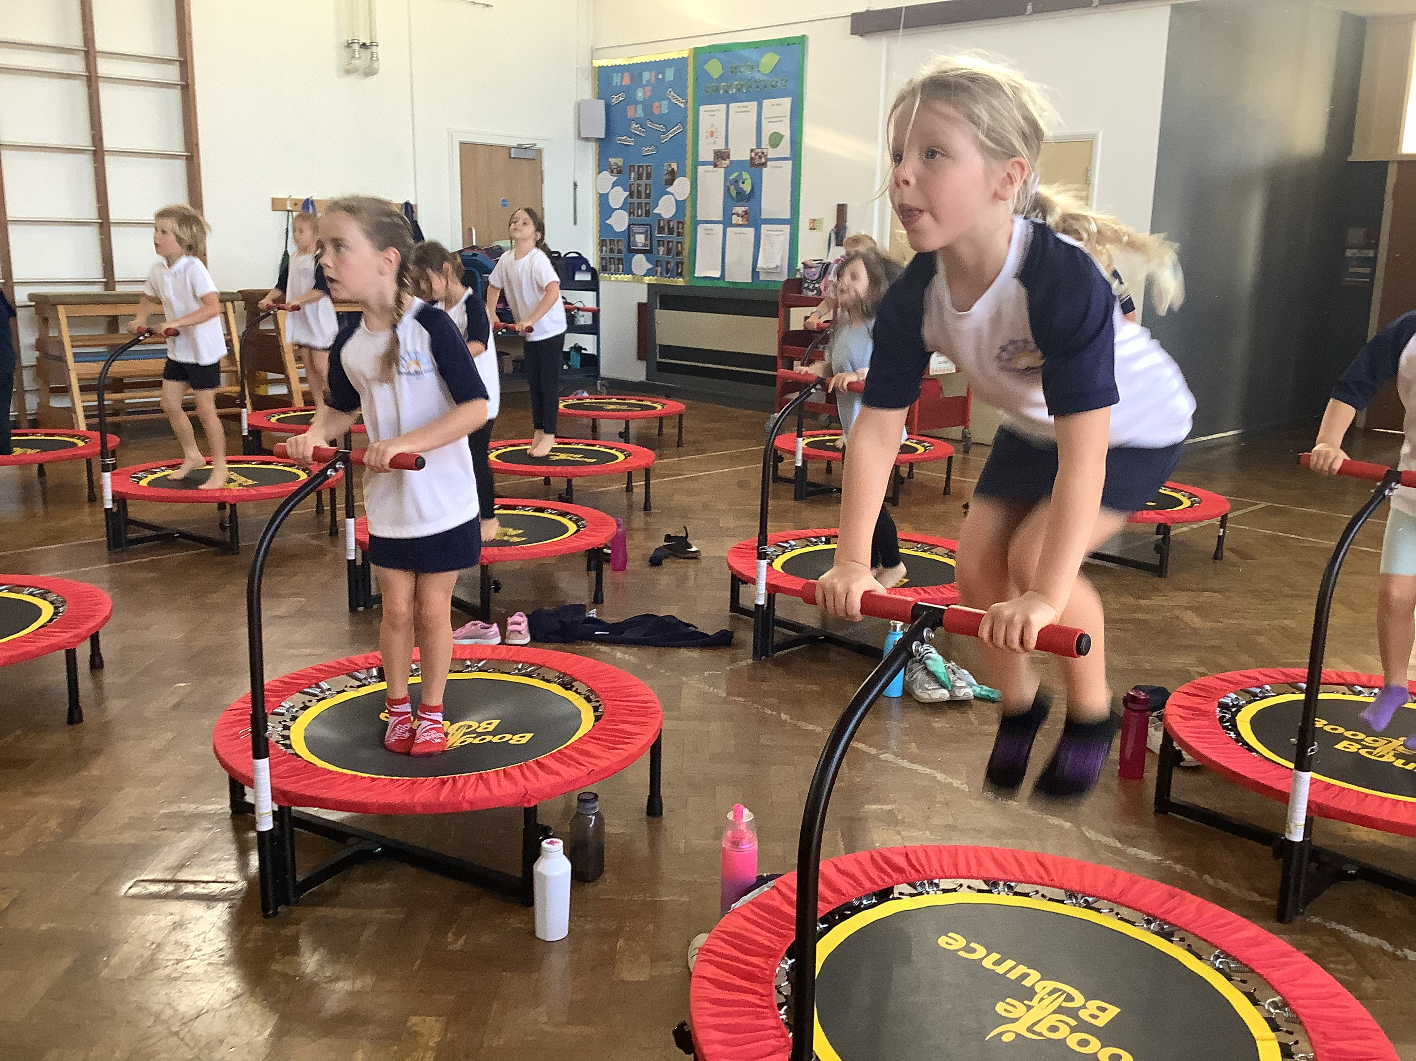
Come to Understand PE at Hemingford Grey Primary School
‘A common language between everyone bringing different countries and abilities together.’

Slide 2
PE and School Sport Report 2023
Our Curriculum
GetSet4PE
Boogie Bounce
Swimming
Well Schools
TEAM

Slide 3
PE & School Sport: The Annual Report 2023
97% of teachers are concerned about the mental health of young people in their school.
Unhappier
Over 3 in 5 (62%) of parents believe that digital distractions mean that their children are spending less time being active.
73% of teachers are concerned about the physical health of young people in their school.
More disconnected
Unhealthier
YST/YouGov Plc, 23rd-24th March (2023),
YST/Teacher Tapp (2023) Survey. Sample of over 8,000 teachers, March 2023.

Slide 4
Addressing the challenges
Social wellbeing
Physical health
Brain function
Mental health

Slide 5
Schools Sports Trust 2023
Schools are uniquely placed to provide opportunities for physical activity for young people, shaping their attitudes to PE, school sport and activity and helping them to develop life-long habits.

Slide 6
PE Curriculum at Hemingford Grey
Fitness
Balls Skills
Dance
Gymnastics
Athletics
Swimming

Slide 7
Reception
Bike Ability
Introduction to PE
Multiskills

Slide 8
KS1

Slide 9
LKS2

Slide 10
UKS2

Slide 11
Inclusive and Challenging
Pupils are appropriately challenged
Teaching style is adapted to meet the needs of the learner

Slide 12
Engagement
Pupils are encouraged to contribute and there is an eagerness to do so
Clear behaviour management consistent with school procedures

Slide 14
GetSet4PE @ Home
www.getset4education.co.uk

Slide 16
Monthly Challenges

Slide 18
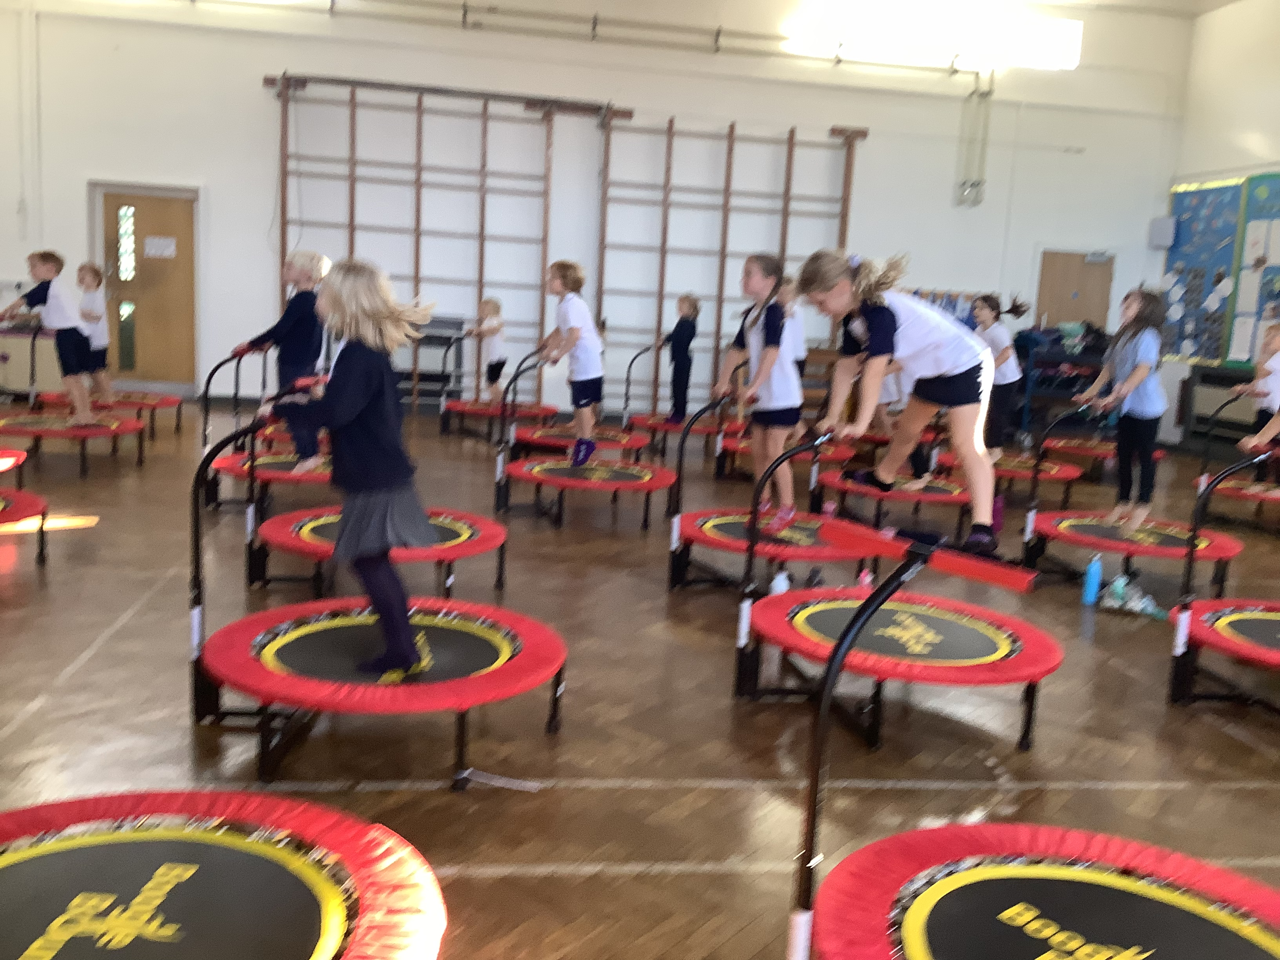
Boogie Bounce
91% of primary and 63% of secondary aged pupils say being active helps them learn
Making lessons more physically active increases children’s attention and engagement in other lessons and improves their overall academic achievement whilst also improving classroom behaviour
Physical activity can enhance cognitive function, brain structure and function as well as improving accuracy in visual working memory and inhibitory control.
Centre for sport, physical education and activity research (spear). (2021) Active Recovery Curriculum

Slide 19
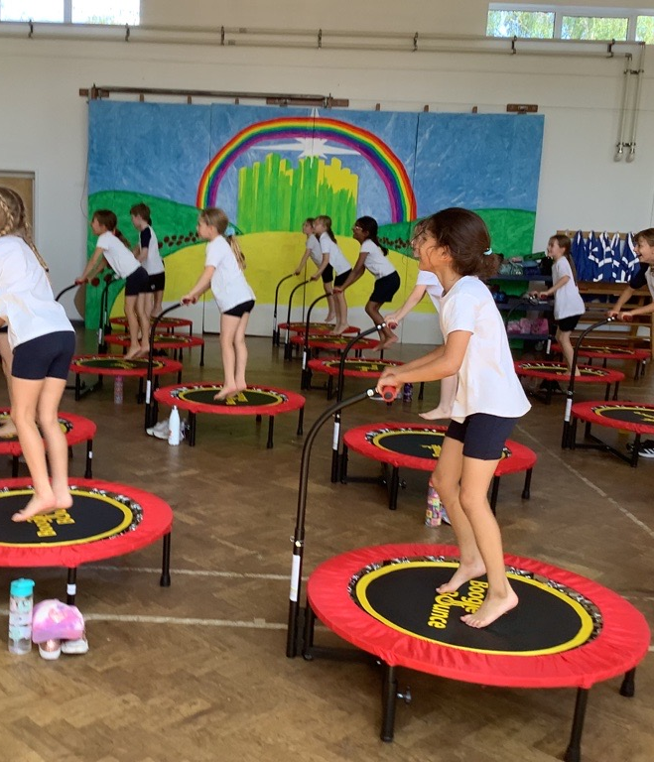
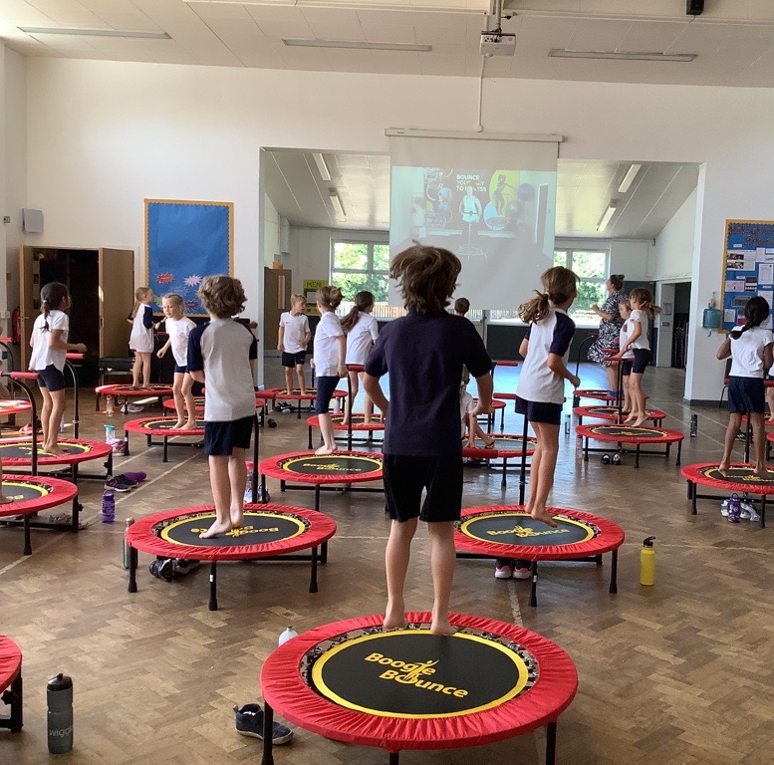
Boogie Bounce Wednesday’s
Embedded into the curriculum
Deploys High Intensity Interval Training (H.I.I.T) techniques and programmes are all inclusive, low impact and above all, FUN!
Improve Proprioception, coordination, balance, flexibility, cardio-vascular efficiency, confidence and motor skills.

Slide 20
Swimming
‘Drowning is the third most common cause of accidental death in children.’
Swimming isn’t just about being able to have fun in the water with family and friends (although it is and you should!). It’s also about knowing what to do if someone gets into trouble. Or if a strong current takes your friend away from the edge. Or you fall in when running by a river or canal.
Swimming is also incredibly good for your physical and mental health and wellbeing – it’s the only activity you can do at any age and at any ability.
Swim England 2023

Slide 21
Hemingford Grey Primary School is a School Swimming and Water Safety Charter school
https://www.youtube.com/watch?v=BvvqYeJC4KU

Slide 22
Our data
What percentage of your current Year 6 cohort swim competently, confidently and proficiently over a distance of at least 25 metres? | 69%
What percentage of your current Year 6 cohort use a range of strokes effectively [for example, front crawl, backstroke and breaststroke]? | 69%
What percentage of your current Year 6 cohort perform safe self-rescue in different water-based situations? | 51% could do it out of their depth. 18% accessed it within their depth but were not confident.
Schools can choose to use the Primary PE and sport premium to provide additional provision for swimming but this must be for activity over and above the national curriculum requirements. Have you used it in this way? | Yes/No

Slide 23
HGPS commitment to Swimming
Half a term of swimming lessons from Year 1 - 6
Summative Assessment
Teacher CPD
Water Safety assemblies for children
Over £8000 of Sports Premium funding was spent on Swimming last academic year for years 1-4
Would you be willing to support us continue with our commitment by supporting the cost of coach fees?

Slide 24
Well Schools
https://www.youtube.com/watch?v=aKPtuRIUzHM

Slide 25
Why have we become a Well School?
We believe in the link between being active and mental health.
‘Schools are reacting to poor wellbeing rather than promoting positive wellbeing’ – we don’t want to be one of those schools.
We are driven to becoming a Creative and Active School

Slide 27
Well Lead
Well Prepared
Well Equipped

Slide 28
School Strategic Development Plan
We will be placing as much emphasis on wellbeing as we do the curriculum because …
‘children and young people are more effective learners when they are happy and well’
https://youtu.be/_hCqmfCkM0g

Slide 29
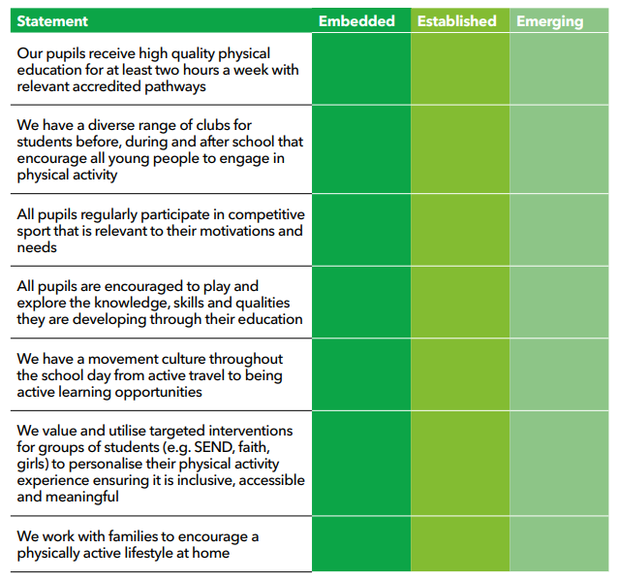

Slide 30
Our steps to better our active school
Running club
Boogie Bounce Wednesday’s
Play Leader training, incorporated with TA training.
Active Families
Active Blasts
Attending more intra-competitions

Slide 31
TEAM – Together, Everyone Achieves More
Team Earth
Team GB
Team Hemingford Grey
Team HGPS
Team Phase
Team Class

Slide 32
We want every child at Hemingford Grey Primary School to be committed to maintaining a healthy and active lifestyle.

Slide 33
Any questions?

