Slide 1
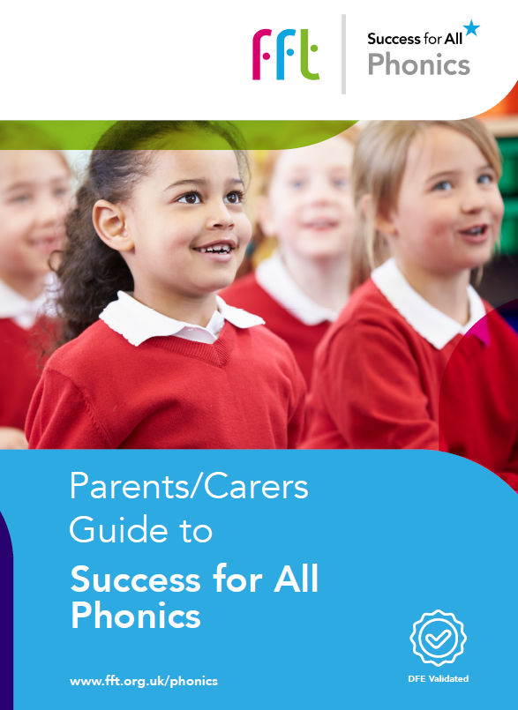
Success for All Phonics
A proven systematic synthetic phonics teaching programme, validated in July 2021 by the Department for Education

Slide 2
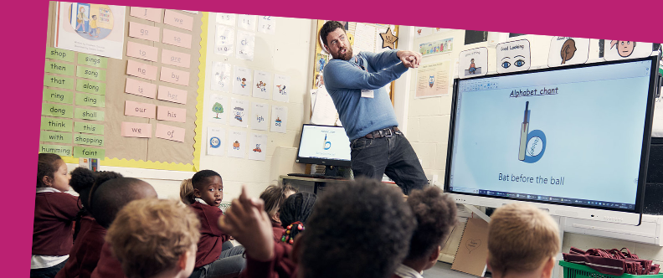
We want to share with you:
Welcome to FFT Success for All Phonics
The background of the programme
An overview of Success for All Phonics and what’s included
Ways to help your child at home and in school

Slide 3
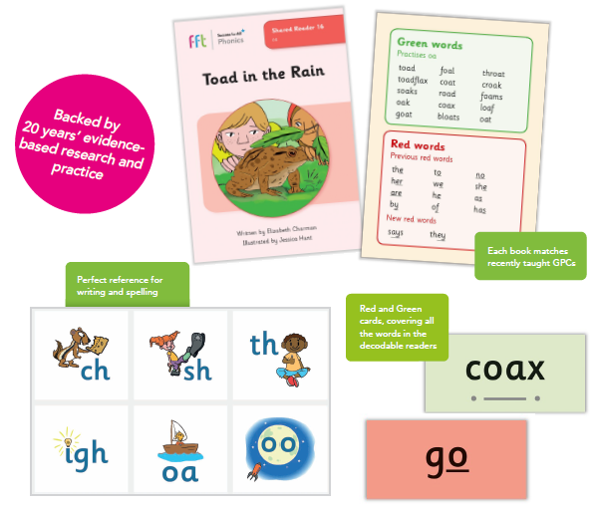
What is included with Success for All Phonics?
Success for All Phonics supports your child to learn all the skills needed to successfully read, write and spell.
It is part of a wide range of literacy programmes that come from FFT.
There are lots of engaging resources e.g. flashcards and sound mats to support learning.
There are also 68 decodable reading books which will be used in class and sent home in either hard copies or digital books.

Slide 4
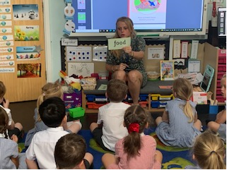
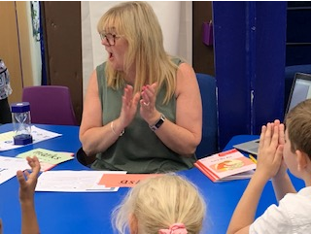
What happens in daily lessons?
Each day:
revisit phonemes and graphemes
consolidate learning before new content is introduced
orally blend
segment
read words and then sentences
Also:
learn the alphabet
how to write letters in upper and lower case
write simple words and then sentences
Reading:
daily opportunities to apply their learning into reading
discussing the text to develop their comprehension skills

Slide 6
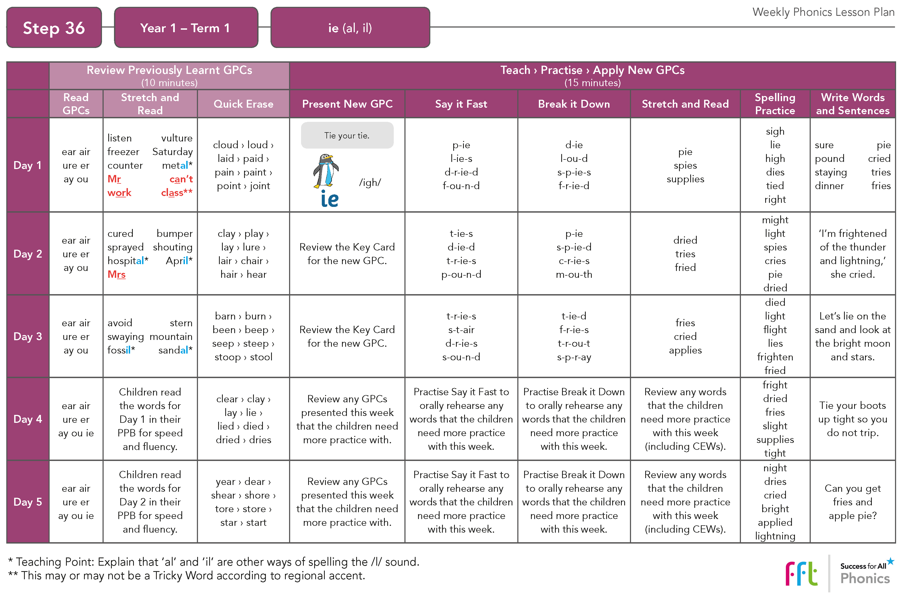

Slide 7
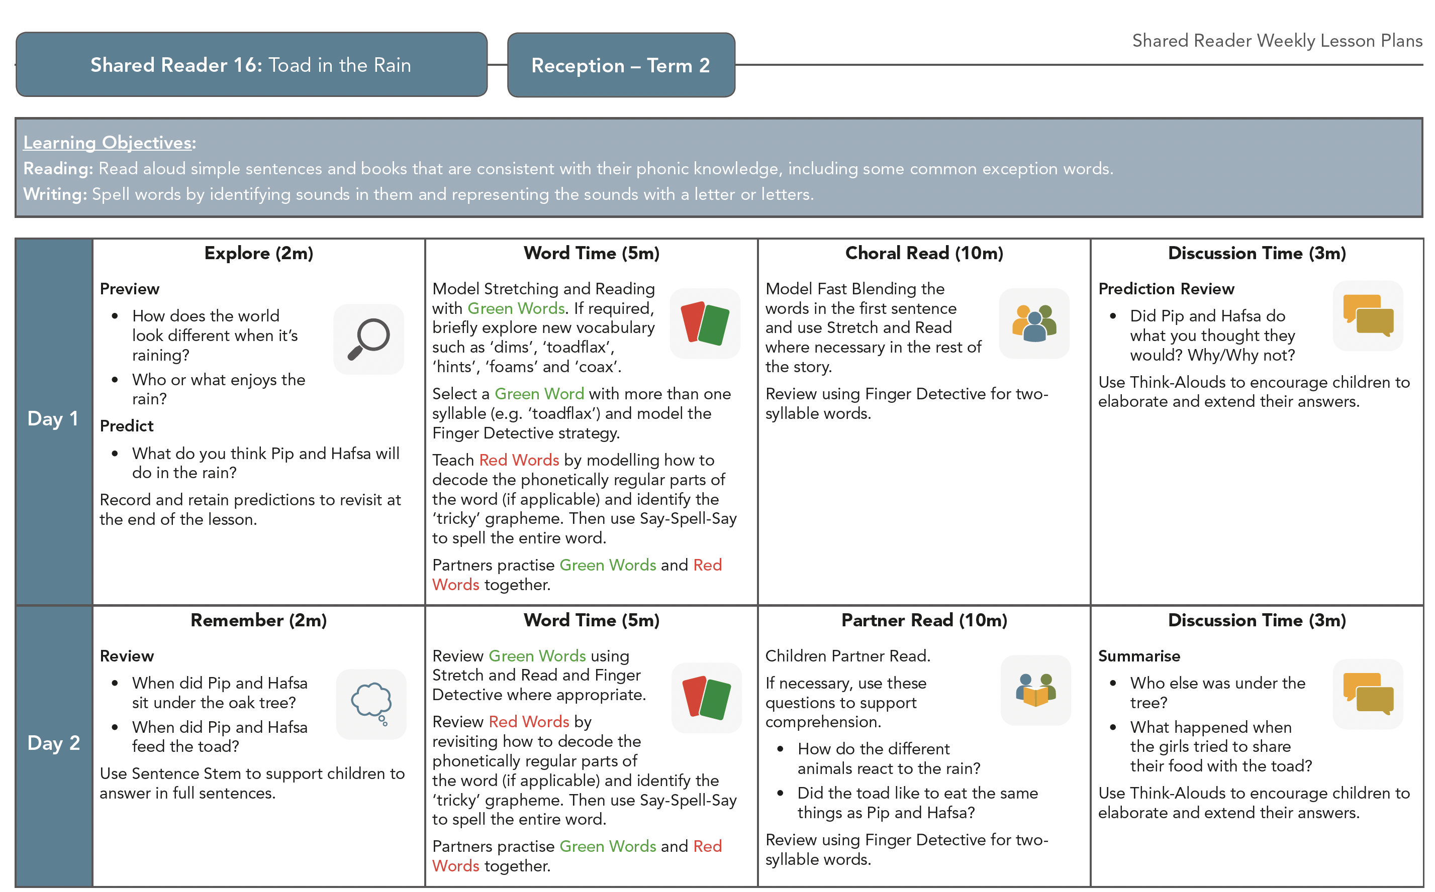

Slide 9
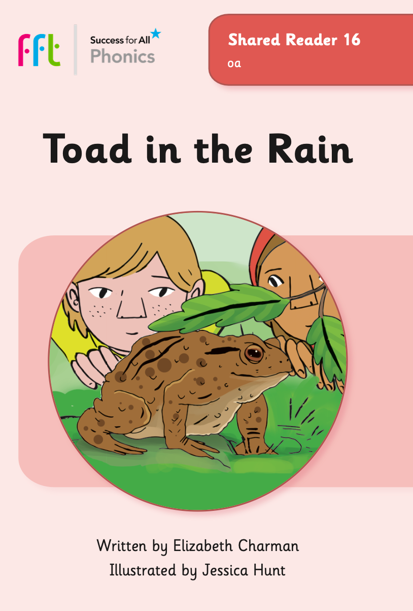
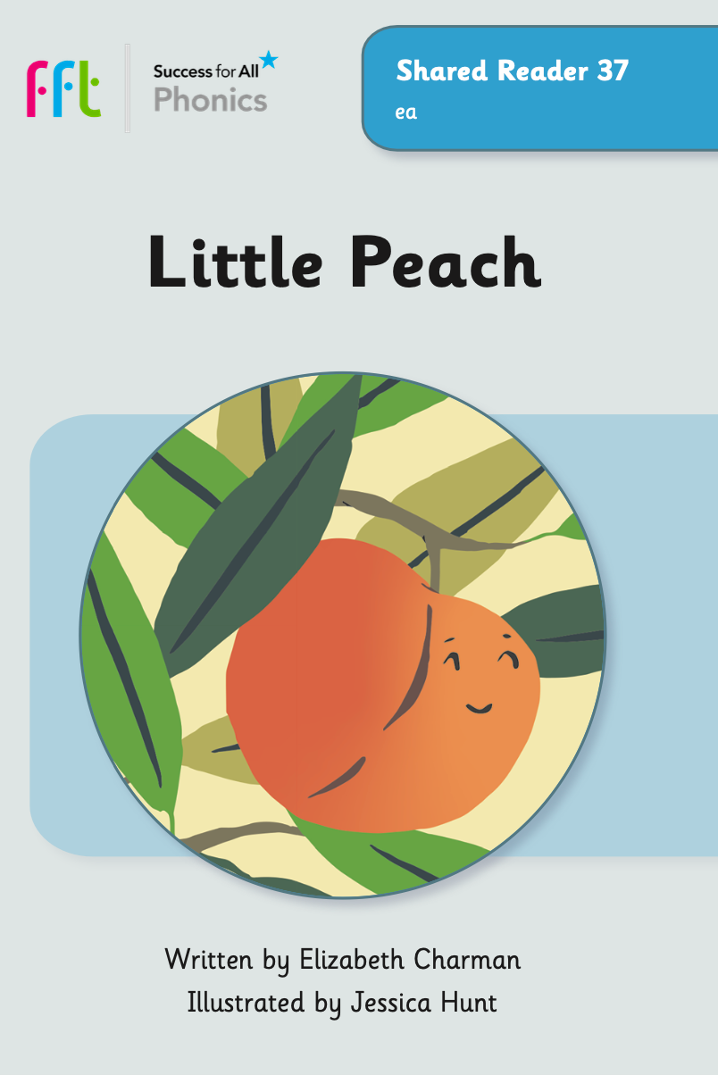
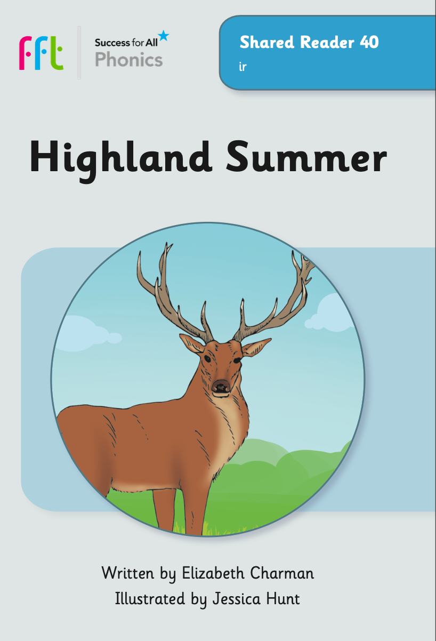
68 fully decodable Shared Readers
68 new decodable Shared Readers, published by FFT
Shared Readers are linked to our scope and sequence and are used in class for the daily reading lessons (children share a book in pairs)

Slide 10
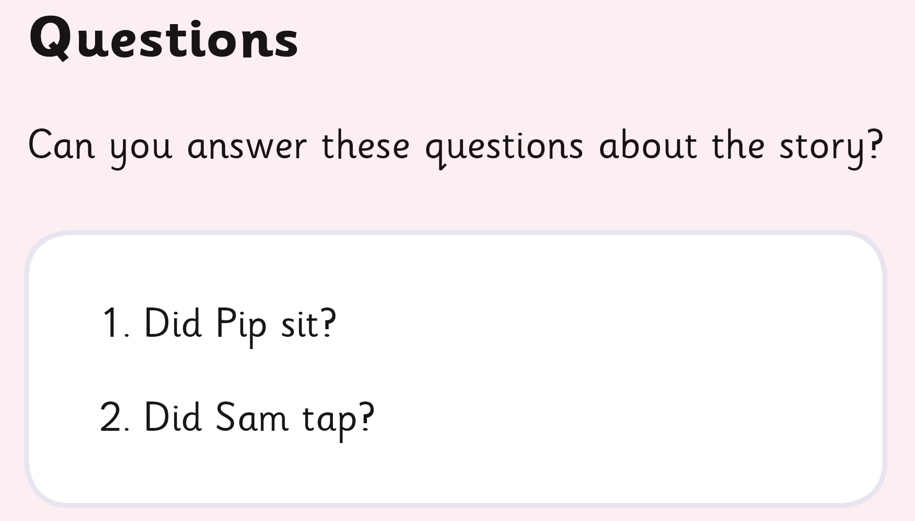
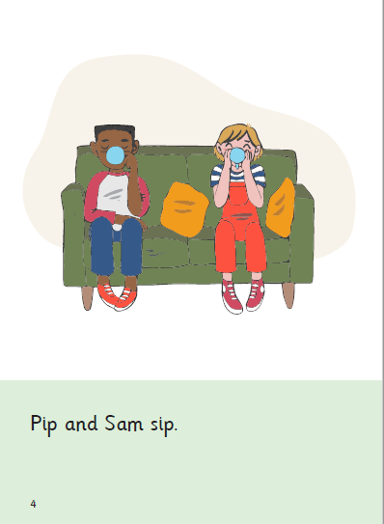
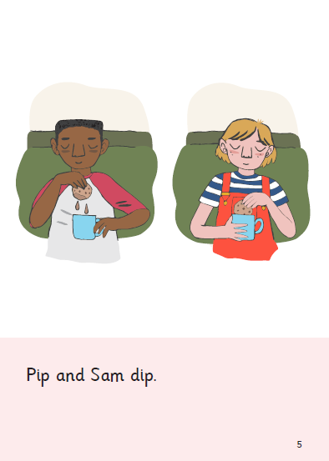
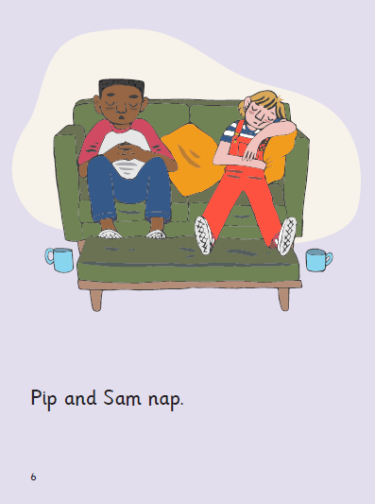
Shared Reader 1: Tap Tap Tap

Slide 11
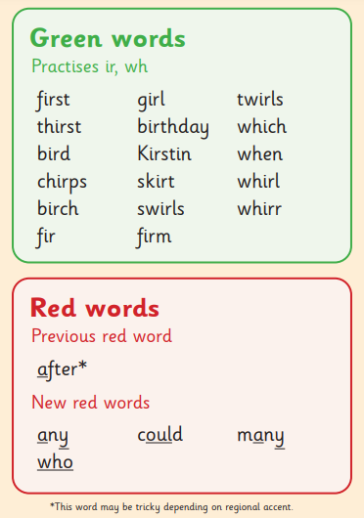
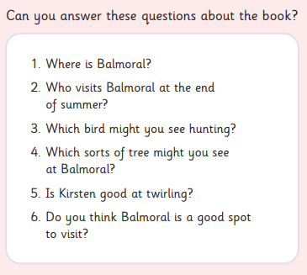
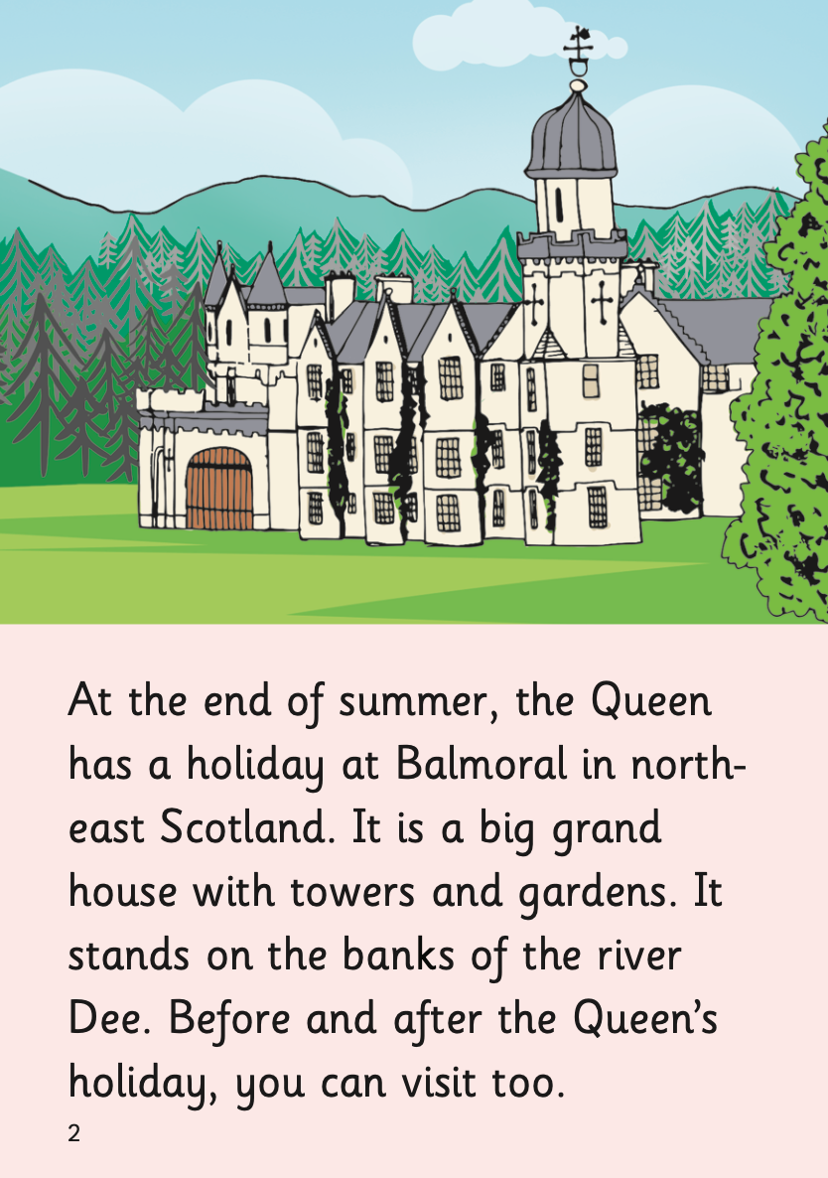
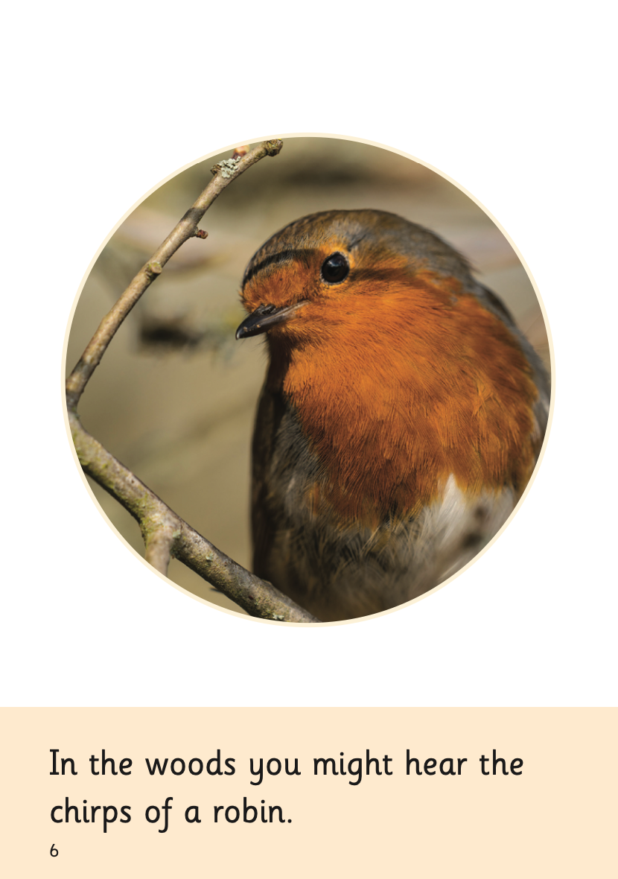
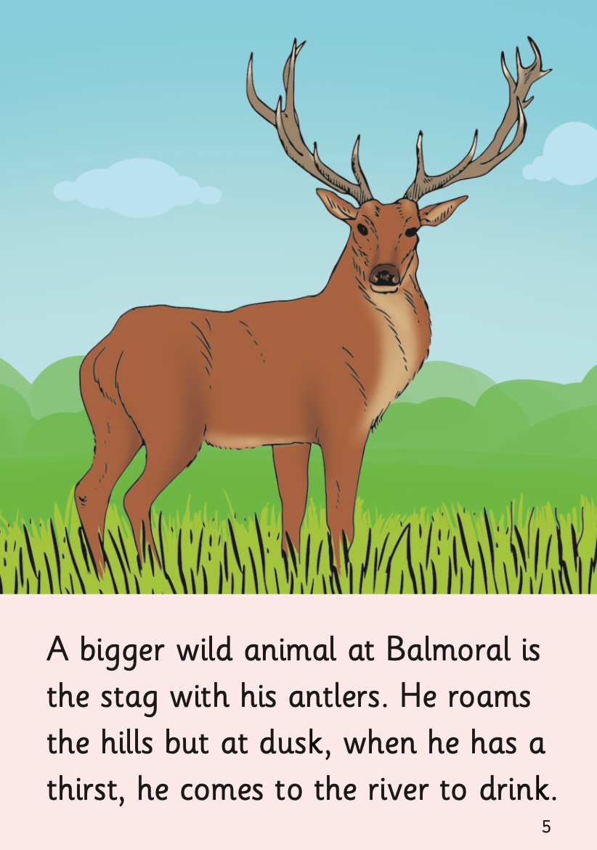
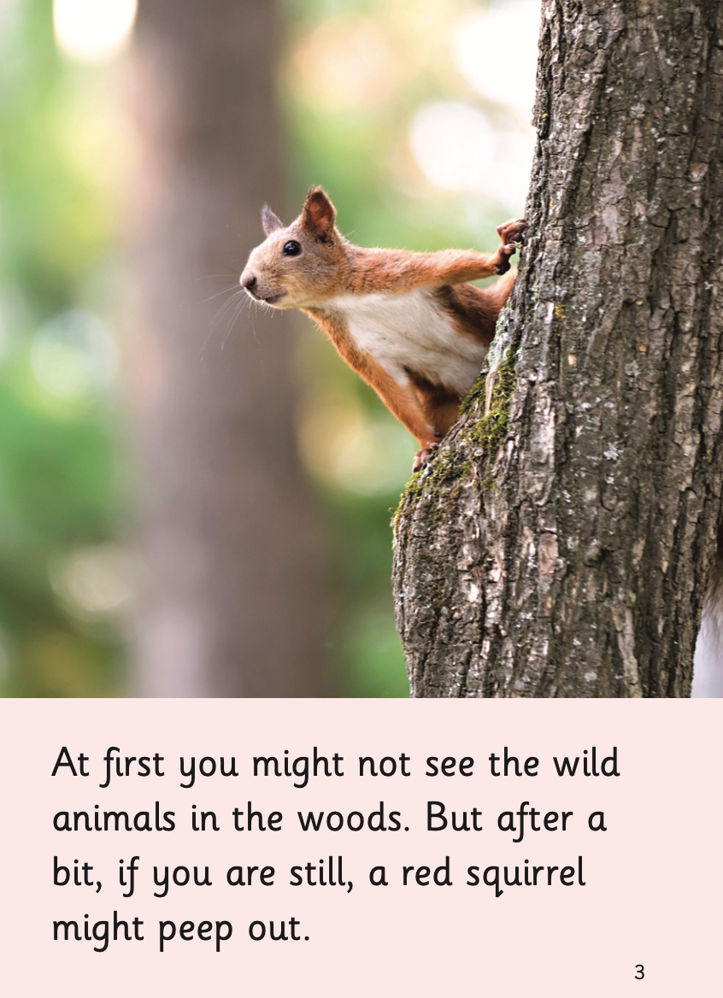
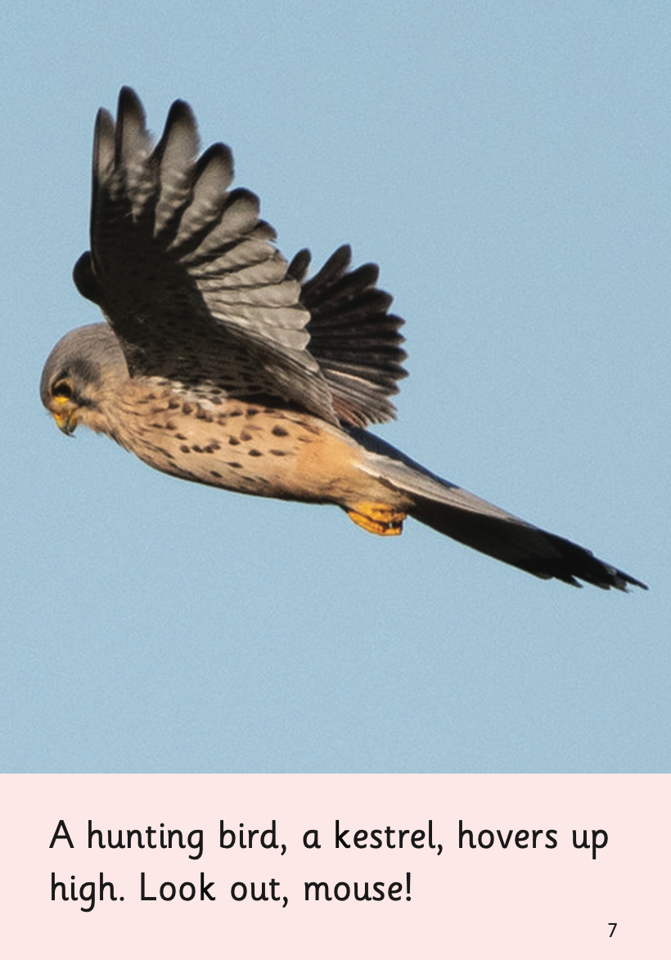
Shared Reader 40: Highland Summer

Slide 12
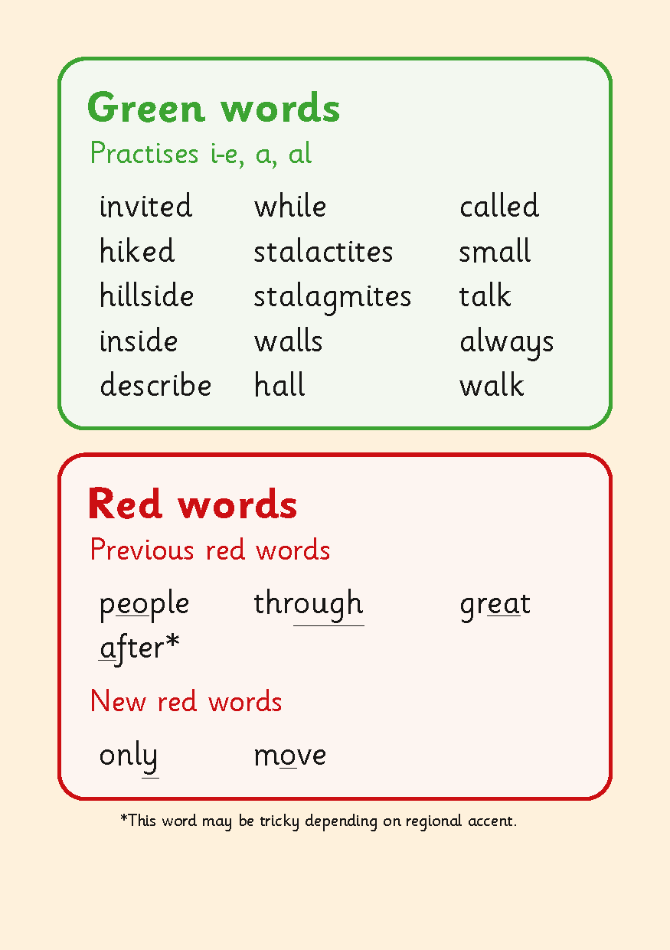
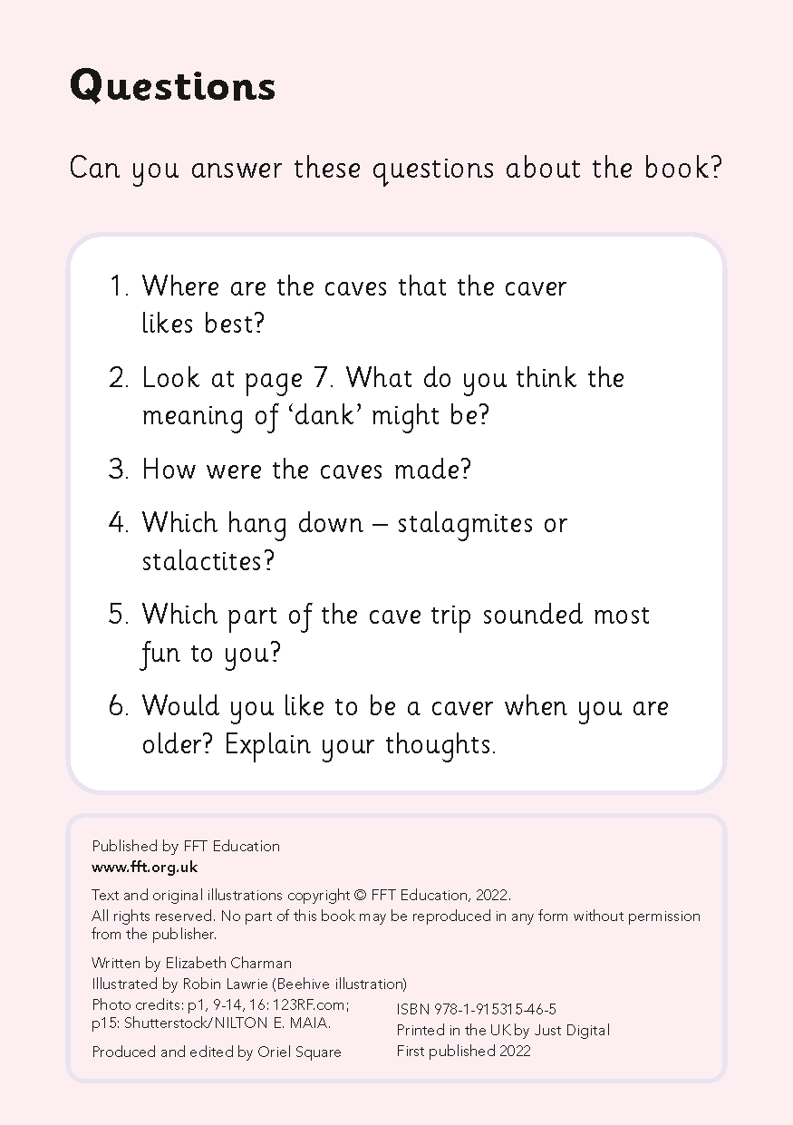
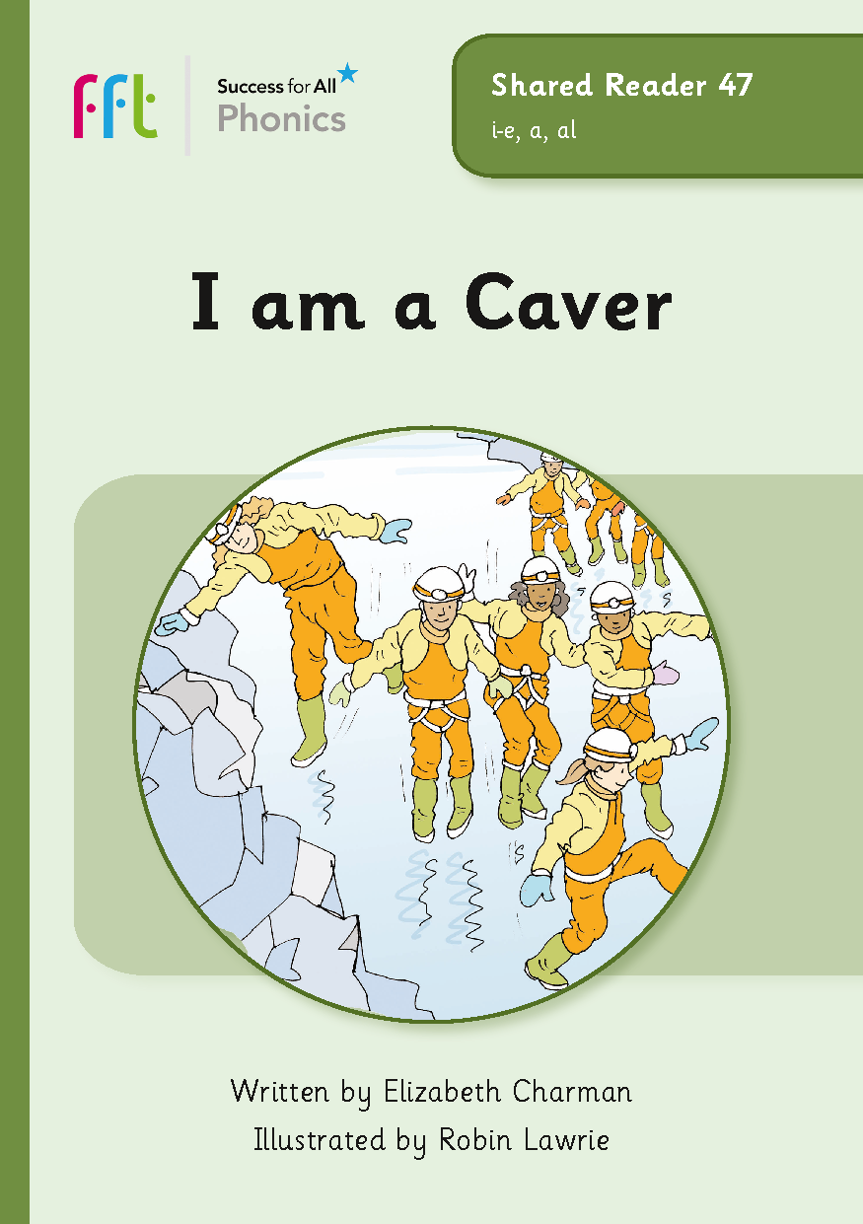
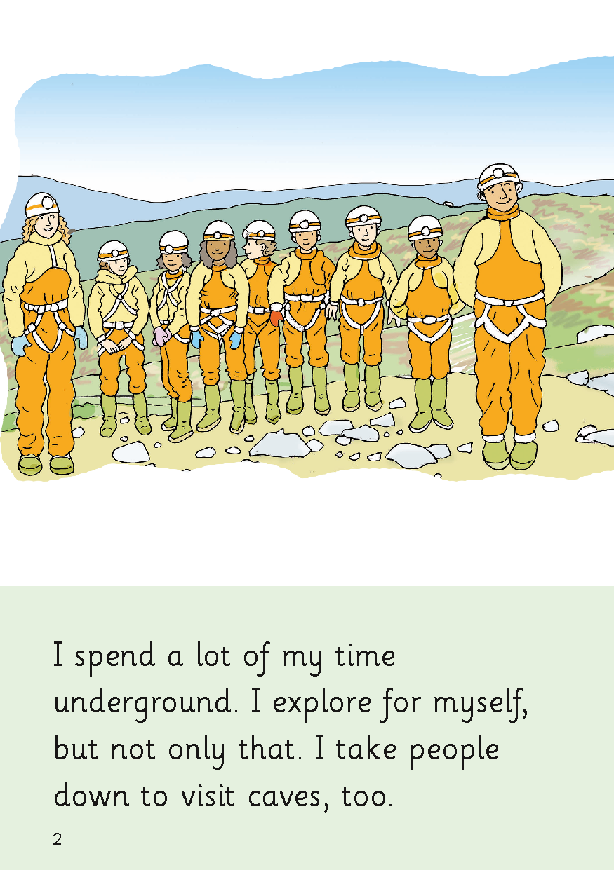
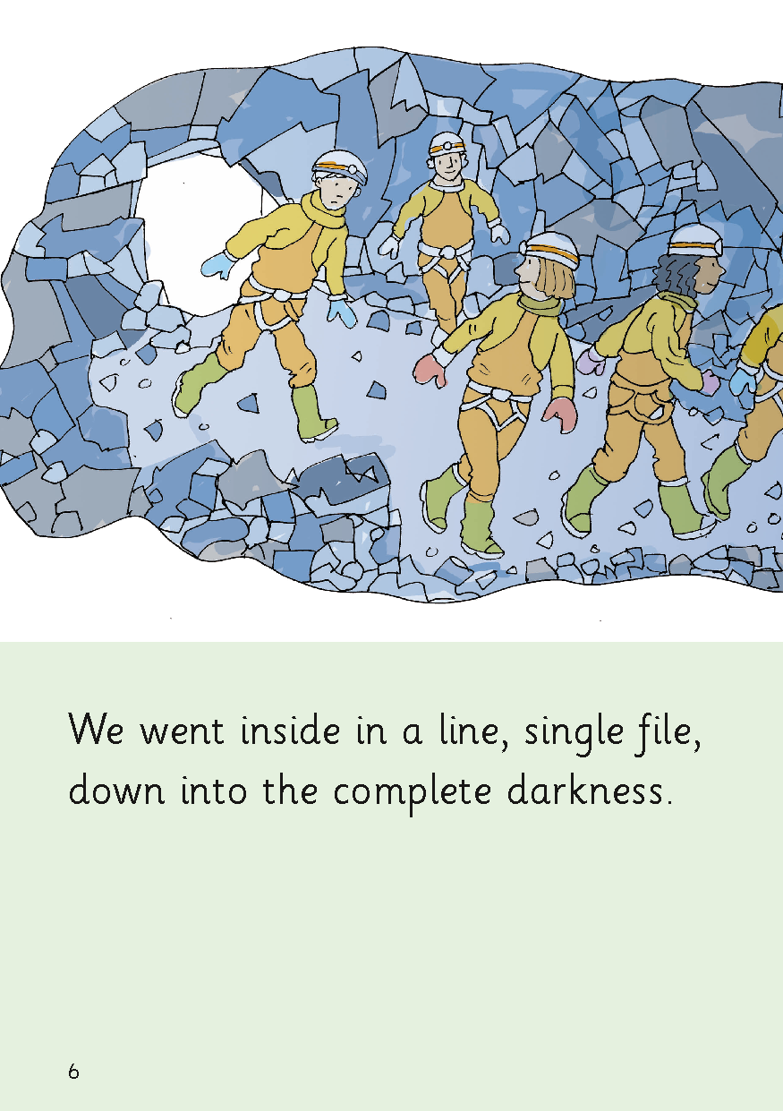
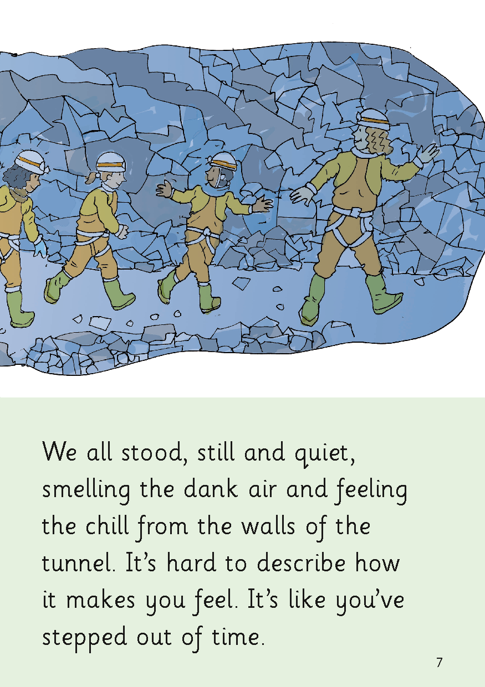
Shared Reader 47: I am a Caver
Notes:
25-30
Continue to explore layout of the books – draw CEW underlining and the separation between previous and new Red Words.
Focus on questions which are all decodable.

Slide 13
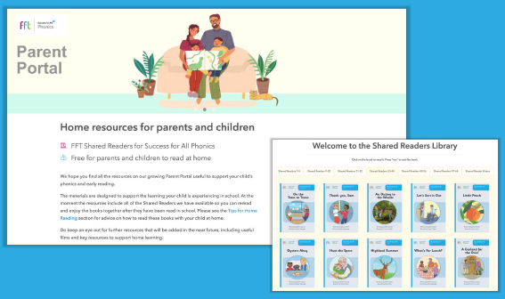
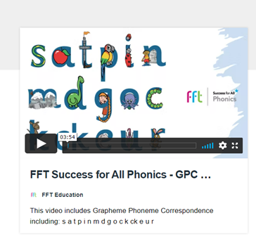
How can I help my child?
Watch videos on the Parent Portal of how to pronounce the GPCs
Use the alliterative phrases to support your child in practising the GPC
Practise reading the Shared Readers at home
Also share other exciting books for pleasure and allow them to hear others read.
Please note: Each school is deciding how best to use the portal for their pupils and parents.

Slide 14
Tips to help:
Know that a GPC is a grapheme phoneme correspondence. That means a sound is matched to one or more written letters: /a/ /ai/ /ay/.
Saying pure sounds is important
some sounds stretch e.g. m, n, r
some bounce e.g. b, p.
say them softly and say a word that begins with the sound to help.
try to avoid a big ‘Uh’ sound at the end
Be aware that your child will be learning GPCs each week and applying them to reading and writing.
The Shared Reader you practise at home with your child will include the focus GPC that they have just learnt that week.
They will have also read that Shared Reader in class that week.

Slide 15
Tips to help:
Understand that it is important not to rush on with reading books that contain unknown GPCs
We are embedding and consolidating learning in a systematic and progressive way
Know that Green words are decodable (you can use phonics to read them)
Red words are tricky words which means they have parts that are not decodable and need to be memorised.
Green and red words may be sent home as spellings.
Reading for pleasure is always welcomed- hearing you read and listening to stories and rhymes is an important part of childhood learning.
It is however important for children to master phonics as their primary decoding strategy so don’t try to push your child on too quickly. Ask your child’s class teacher if you are unsure.

Slide 16
If I have a question about my child, who should I contact?
Look at the information FFT Success for All Phonics provides to see if that will help you first.
If you need further information, then contact your child’s teacher as they will know your child the best and how the programme is running in your child's school.

Slide 17
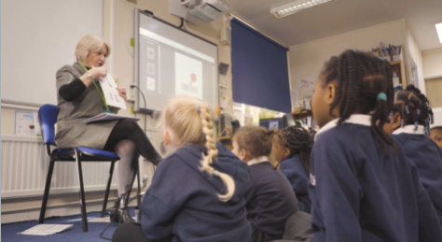
What is Ofsted saying?
"They have put in place a well-planned phonics programme and trained all classroom staff to deliver it.“ "Staff are experts in teaching reading..” "Classroom visits to Reception and Years 1 and 2 showed pupils enjoying their phonics lessons." "Pupils show a genuine love of reading.” “They aptly notice when pupils need more teaching and practice to catch up”

