Slide 1
Year 1 Phonics screening test
February 2024

Slide 2
Aims
Have a clear understanding of what the phonics test will look like and when it will take place
Understand how the phonics test will be administered
Understand how the children will be prepared for the test
Understand how you can support your child at home
Understand how the results will be reported to parents
Understand what happens if your child does not pass the phonics test in Year 1

Slide 3
Have a clear understanding of what the phonics test will look like
The test will be administered during the week beginning 10th June 2024. During this week children will access the test on a 1:1 basis.
The test is purely testing their phonics knowledge.
The test is made up of 40 words, 20 of which are real and 20 words known as pseudo words (made up words) which the children will be asked to read.

Slide 4
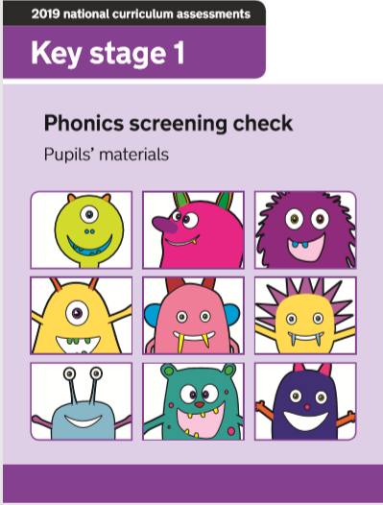
Example paper

Slide 5
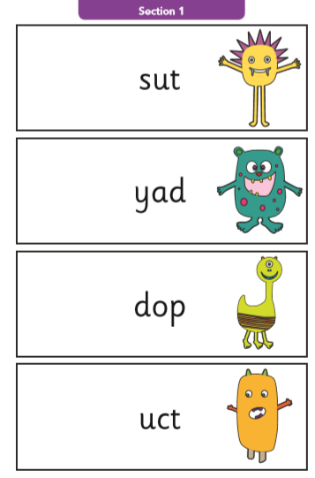

Slide 6
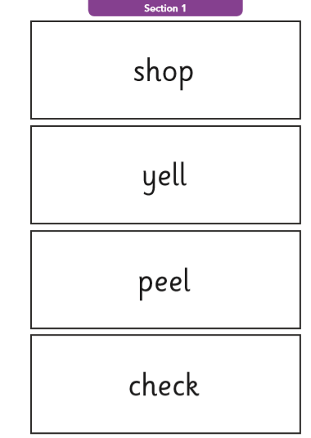
Notes:
Section 1 – Phase 3 phonemes

Slide 7
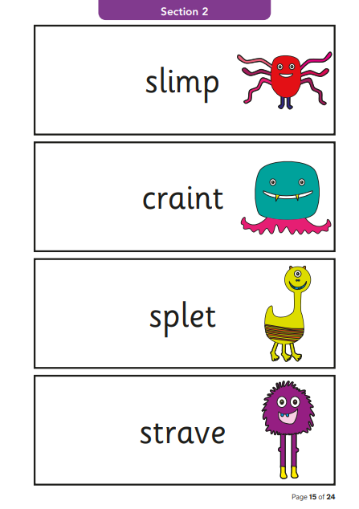

Slide 8
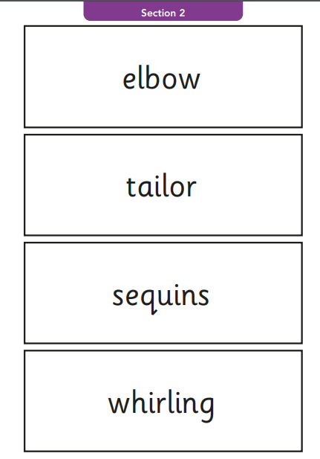
Notes:
Section 2 – phase 5 / alternatives phonemes

Slide 9
Understand how the phonics test will be administered
Test will be administered by a familiar adult
1:1
Quiet space with no distractions
Notes:
3 phoneme hold

Slide 10
Understand how the children will be prepared for the test
Children will not experience anything other than Quality first phonics teaching leading up to the test. It will be kept very low key and all children will have been given the best opportunities to be ready for the test.
Children will be taught strategies to support them to access the test during their phonics lessons.
Children will be encouraged to use sound buttons when completing the test as this is part of their normal approach to sounding out unknown words.

Slide 11
Understand how you can support your child at home
Make reading fun
Have your child help you read out everyday words around them like the shopping list.
Encourage and support them to recognise when more than one letter make a sound E.G: car

Slide 12
Understand how the results will be reported to Parents/Carers?
Pass marks will be made available to the school and this information can then be used to know whether the children have passed the test. These results will be collated as a school and submitted to the Local Authority.
Results will be shared along with the children's end of year outcomes.
2023 91% of our children passed!
2023 National average 79%

Slide 13
What happens if your child does not pass the phonics test in Year 1?
DO NOT WORRY!
We are interested in providing your children with a skill which will help them become readers, not pass a phonics test. Whilst we will do everything we can to give them the best opportunities of passing, if they don’t the test will be re-administered when the child is in Year 2.
Over this year, children may require some intervention to support their phonics.

Slide 14
Learning videos

Slide 15
Questions?

