Slide 1
Hemingford Grey Primary School Governor Newsletter
February 2023
The governing body has undergone a few changes this year. We now have a new Chair: Vanessa Allen. She has taken over from Helen Peat, who successfully and expertly chaired the board for most of the last 10 years. We thank Helen for all her amazing work and are pleased that Helen remains an active governor with the school.
We have been pleased to welcomed two new governors - Danielle Saunders and Amelia Beeley – they bring skills and experience that can be utilised for the work of the governing body. Sadly, we have said goodbye to Jenny Jones who leaves governing after 7 years at the school, Hannah Gill a governor for 2 years and Darren Walsh who was a parent governor for 2 years. They have played a part more recently in discussions and decisions about restructuring the governing body, asking challenging questions and helping to keep our focus strategic, and undertaking monitoring activities.
We are carrying out a recruitment exercise to attract new governors to fill the vacancies. The parent governor vacancy has been advertised and nominations close on Monday 27 February. Advertising for the co-opted / community governor vacancies has gone out to local business, charities and voluntary groups and posted on various Facebook Groups in Hemingford Grey, St Ives and the surrounding villages. There is information on the school website about the governor role, so if you know of someone who would make a good governor (maybe a grandparent, friend, neighbour or colleague) direct them to our website. We are looking for people with a range of skills and experience (an education background is not required!).
We've restructured our board and committees so that we can work more efficiently. The size of the governing body has reduced. We now have 11 monthly full governing body meetings throughout the year. The previous curriculum and resources committees have been incorporated them into the full governing body meetings. As a result, all governors are better informed, have oversight of all work of the governing body and by meeting monthly we can better meet the needs of the school. We'll be reviewing this throughout the year to ensure we work in the best way to support the school.
Some of our key activities so far this school year have included:
Approving the school’s strategic development plan (SDP)
Planning our governor monitoring visits for the year – aligning to the SDP so governors can check what we are being told is happening on the ground.
Monitoring visits completed - safeguarding, early years, staff appraisals and health & safety.
All governors met for a day early in February for a focus on monitoring and a training session with the schools designated Primary Advisor. We heard from the lead staff members for: Inclusion and SEND, Reading, and Science. We then carried out monitoring around school, going into classrooms to look at learning and the learning environment, and talking to children, to test whether what we had heard we could see on the ground; and the conclusion …. YES! It was a very informative and interesting day.

Slide 2
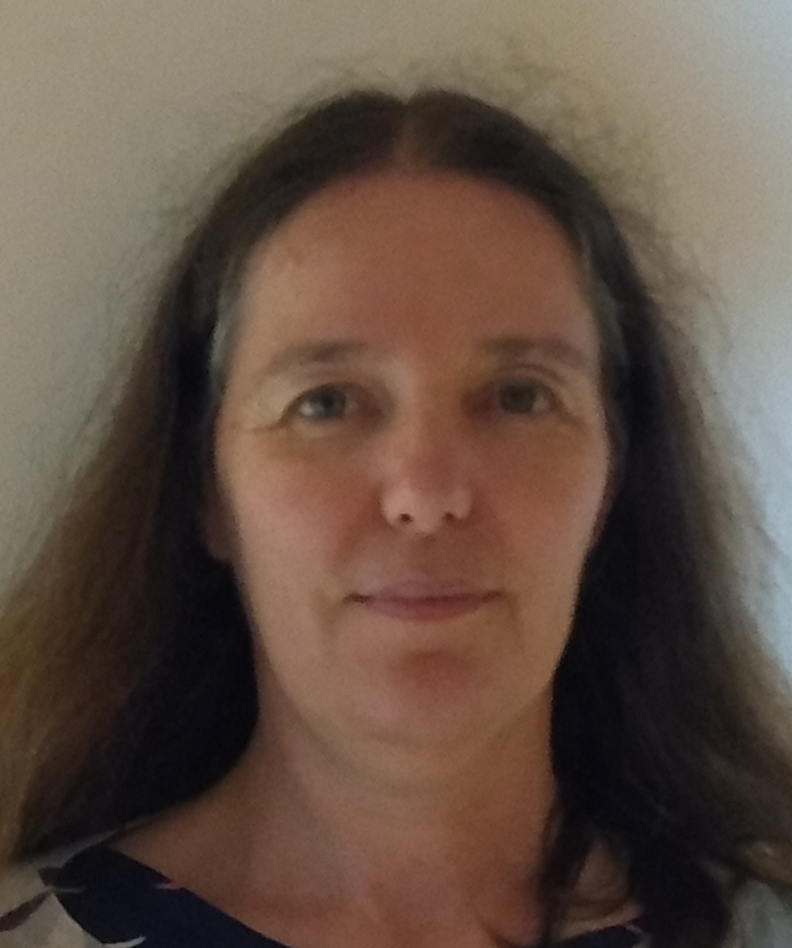
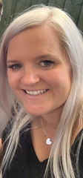
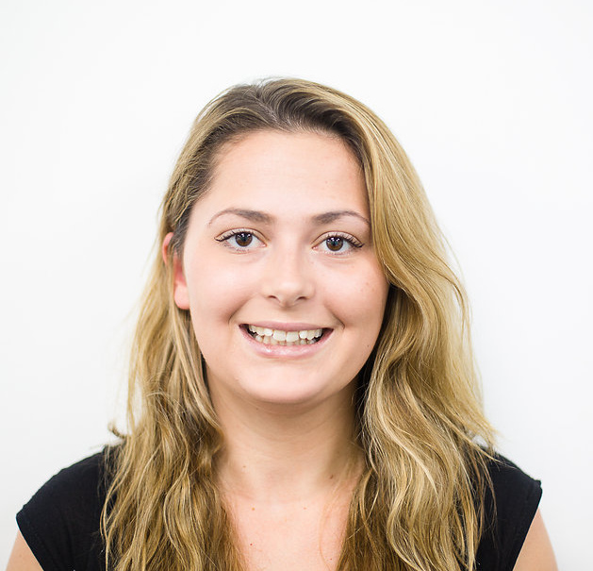
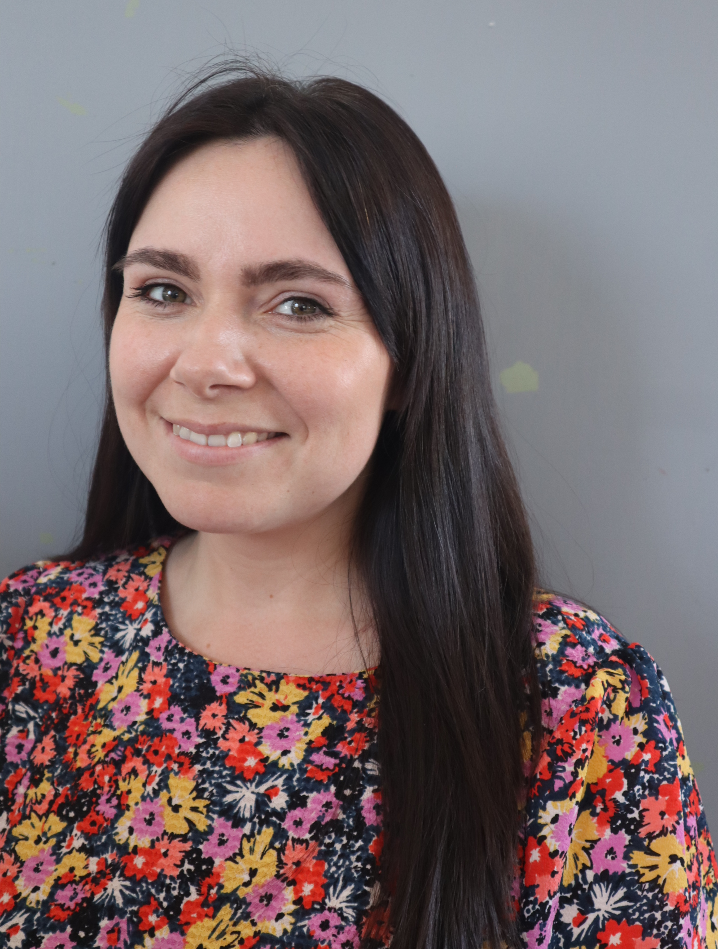
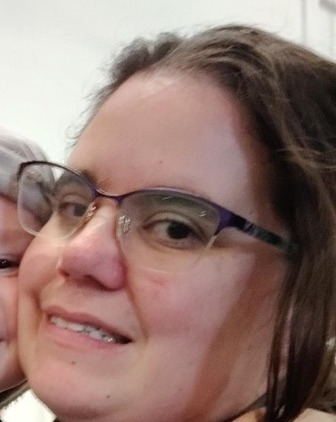
Who is your Governing Board
 | Vanessa Allen | Chair and Parent Governor | I've been part of the board since 2016. I live in Hemingford Grey and work part-time for a housing association managing older peoples housing. Two of my three children are still at HGPS with the third now at secondary school.
 | Helen Peat | Co-opted governor | I've been on the Governing Board since 2002 when my (now grown-up) children were at the school taking on a variety of roles and chairing for 10 years. Professionally, I work at the British Antarctic Survey, and I also volunteer with the RSPB and on School Admission Appeals Panels.
 | Danielle Saunders | Parent Governor | I am a Mum of three, two who attend Hemingford Grey School and Pre-School. I have been a secondary school teacher for 10 years, and a Safeguarding lead too. I joined the governing board around a year ago as a parent governor and hope my safeguarding and education knowledge supports me in my governor role.
 | Amelia Beeley | Co-opted Governor | I am a mum of two, who moved to Hemingford Grey in 2022 and joined the governing body to give something back to the village. I work implementing development and humanitarian programmes globally, and hope to bring the variety of my professional experience to support me in the governor role.
 | Kristi Johnson | Parent Governor | I joined the governing body as a Parent Governor in 2021. I have two children at the school so keen to ensure the school can be the best it can be. My background is finance and knowing how important school budgeting is, I wanted to be able to use my professional experience to give back to the local community.
 | Danielle Jermy | Staff Governor | I was delighted to join the Hemingford Grey Team as deputy headteacher in 2019. Prior to this I have been teaching and leading in schools in Milton Keynes and Hertfordshire. My roles in school also include, Pupil Premium Lead, Domestic Abuse Lead, Mental Health First Aider and Behaviour Lead. My passion and motivator is to develop an inclusive school where everyone feels valued and successful.
 | Carlie Huddleston | Clerk to the Governors | I started Clerking for the Governors in May 2022. I am a Mum of Four, with two children currently attending Hemingford Grey School. My job is to carry out the administration duties for the Governors along with attending meetings and taking the minutes.

